Slide 1
NYC Taxi vs. Ride Sharing Preferences
Presented by:
Feng-sheng Hu
Mohamed Obaidulla
Harneet Kapil
Mark Reilly

Slide 2
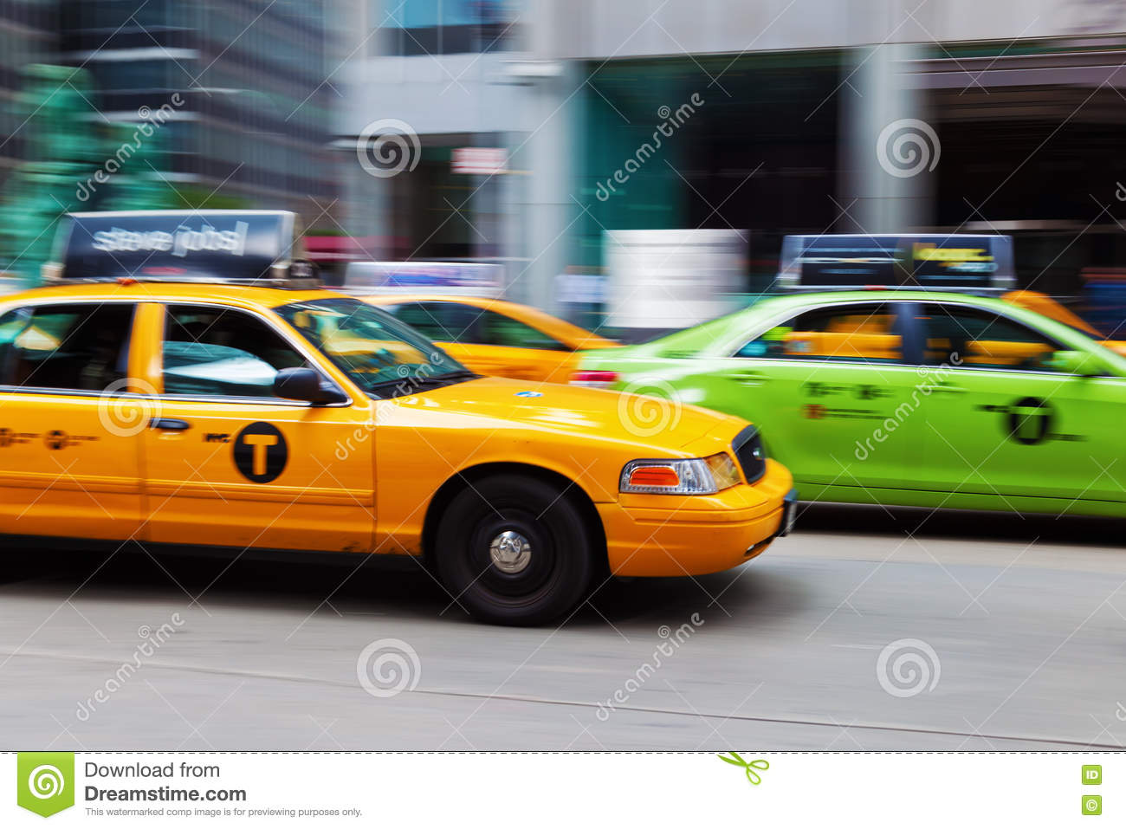
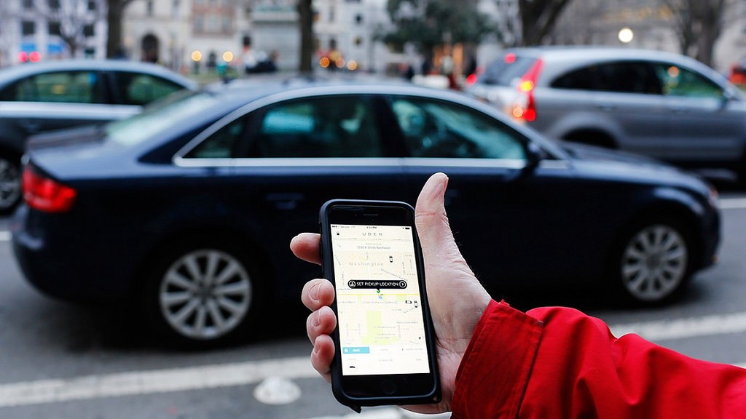
Different choices for riders
NYC yellow taxis - can pick up and drop off in all boroughs
NYC green taxis – can only pick up outside of Manhattan
Ride sharing services or car services – e.g. Uber, Lyft, or private cars

Slide 3
Questions to be Answered
In which areas are taxis more popular than FHVs?
Do places of interest (sports venues/airports) effect the preference of taxi vs. FHV?
What effect does weather (Temp, snow, rain) have on usage of yellow or green taxis vs. For-Hire Vehicles (FHVs)?

Slide 4
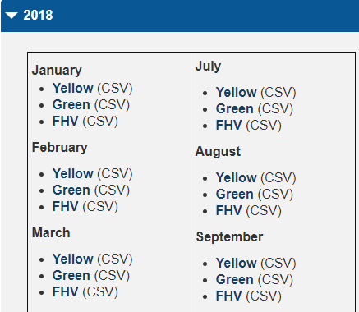
Sources of data
NYC Taxi and Limousine Commission website:
https://www1.nyc.gov/site/tlc/about/tlc-trip-record-data.page
2018 TLC & NYC Ride Pick Up Locations
NOAA Website
https://www.ncdc.noaa.gov/cdo-web/datatools/findstation
2018 NYC weather data
Google API
For airport and sporting venue locations
NYC Ride Pick Up Locations latitude and longitude

Slide 5
Data Preparation
Cleanup, Aggregation, and Exploration Process:
TLC
Collected raw data and identified common fields (Pickup_Date and Pickup_Location_ID)
Files were enormous so there was no way to visually troubleshoot them
We got rid of null rows and trips that did not occur in 2018
Aggregated TLC data for each Ride Pick Up Location and Month combination
Combined green and yellow taxi data together then merged with FHV month by month
Locations
Used Google API to map locations with latitude and longitude data
Identified and dropped bad data that had duplicate locations
Weather
Identified snow days, temperature, and precipitation amounts from NOAA data

Slide 6
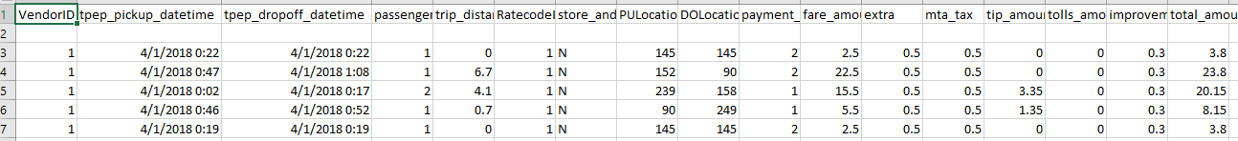
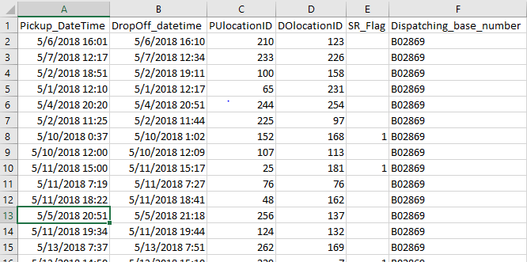
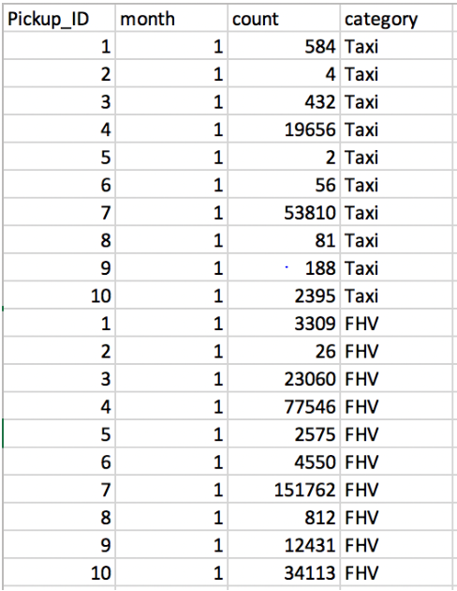
Data Preparation (Contd.)
Illustration of Raw Vs. Cleaned/Aggregated “TLC Rides” Data:
Raw Data
Cleaned and Aggregated Data
TLC Trip data in 2018:
Yellow Taxi (Jan-Dec): 12GB
Green Taxi (Jan-Dec): 1GB
FHV (Jan-Dec): 24GB

Slide 7
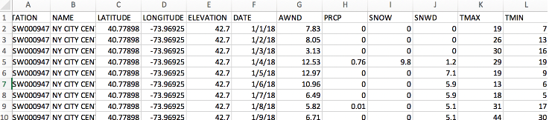
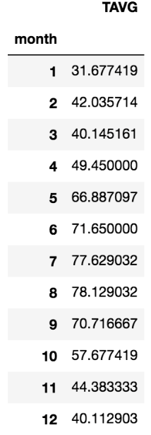
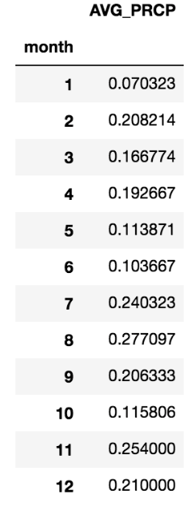
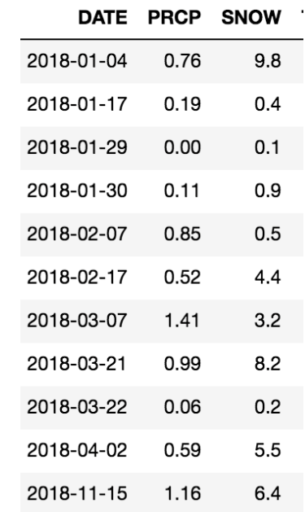
Data Preparation (Contd.)
Illustration of Raw Vs. Cleaned/Aggregated “Weather” Data:
Cleaned and Aggregated Data

Slide 8
Data Preparation (Contd.)
Illustration of other Key data enriched using Google API:
TLC Ride Pick Up Locations in NYC:
Sports Venues in NYC:
Zone | LocationID | borough | Lat | Lng
Newark Airport | 1 | EWR | 40.68953 | -74.1745
Jamaica Bay | 2 | Queens | 40.60566 | -73.8713
Allerton/Pelham Gardens | 3 | Bronx | 40.86542 | -73.852
Alphabet City | 4 | Manhattan | 40.72584 | -73.9775
Arden Heights | 5 | Staten Island | 40.5568 | -74.1739
Arrochar/Fort Wadsworth | 6 | Staten Island | 40.60121 | -74.0579
Astoria | 7 | Queens | 40.76436 | -73.9235
Astoria Park | 8 | Queens | 40.77925 | -73.923
Auburndale | 9 | Queens | 40.75777 | -73.7834
Baisley Park | 10 | Queens | 40.67378 | -73.786
Bath Beach | 11 | Brooklyn | 40.60389 | -74.0062
Battery Park | 12 | Manhattan | 40.70328 | -74.017
Battery Park City | 13 | Manhattan | 40.71158 | -74.0158
Bay Ridge | 14 | Brooklyn | 40.62637 | -74.0299
Bay Terrace/Fort Totten | 15 | Queens | 40.79222 | -73.7761
Venue | Latitude | Longitude
Citi Field | 40.7571 | -73.8458
Yankee Stadium | 40.8296 | -73.9262
Madison Square Garden | 40.7505 | -73.9934
Barclays Center | 40.6826 | -73.9754
MetLife Stadium | 40.8128 | -74.0742
Prudential Center | 40.7335 | -74.171
Airports in NYC:
Airport | Latitude | Longitude
John F. Kennedy International Airport | 40.64131 | -73.7781
Newark Liberty International Airport | 40.68953 | -74.1745
LaGuardia Airport | 40.77693 | -73.874
Westchester County Airport | 41.06833 | -73.7087
Teterboro Airport | 40.85833 | -74.0615
Republic Airport | 40.72613 | -73.4168
Newark international airport | 40.69037 | -74.1776

Slide 9
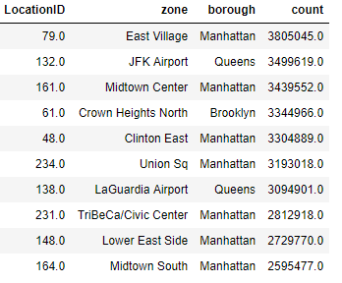
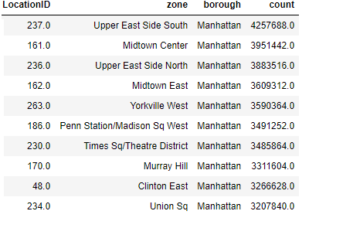
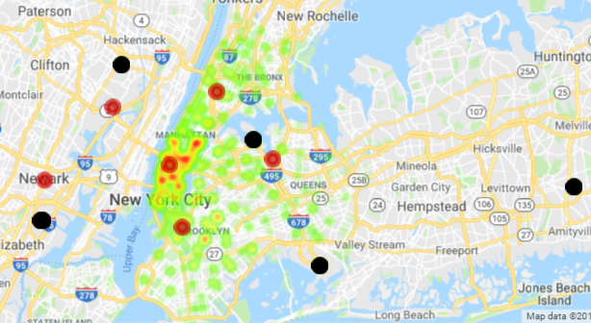
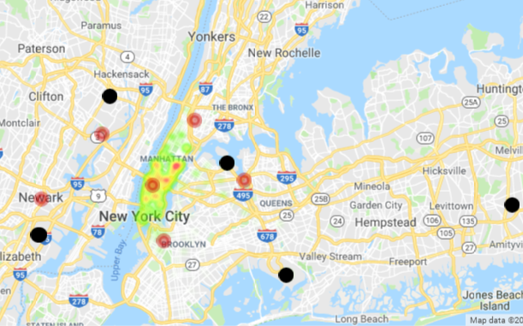
Analytic Questions and Finding
Q1 In which areas are taxis more popular than FHVs?
Q2 Do places of interest (sports venues/airports) effect the preference of taxi vs. FHV?
Airport
Sports Venue
Airport
Sports Venue
FHV Taxi
FHV’s are more popular overall in NYC and suburbs
Sports Venues do not have any impact on the rider’s preference
FHV’s are preferred over Taxi’s for Airport Rides

Slide 10
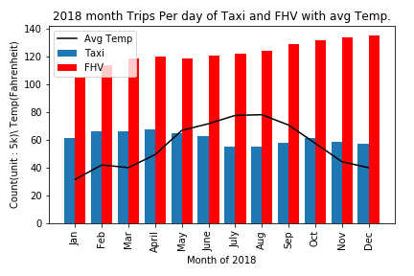
Analytic Questions and Finding
Q3 - What effect does weather (Temp, Rain, and Snow) have on usage of yellow or green taxis vs. For-Hire Vehicles (FHVs)?
Temperature
Given a p-value of 0.4, we choose to accept the null hypothesis, and therefore Temp. wouldn't effect the willing people take a FHV or Taxi.
Spearman Correlation Test
Correlation | P-value
0.279 | 0.379

Slide 11
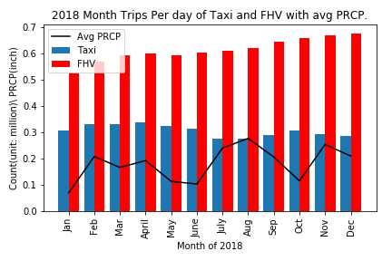
Analytic Questions and Finding
Q3 - What effect does weather (Temp, Rain, and Snow) have on usage of yellow or green taxis vs. For-Hire Vehicles (FHVs)?
PRCP (Rain)
Given a p-value of 0.1, we choose to reject the null hypothesis, and therefore Rain would effect the willing people take a FHV or Taxi.
Spearman Correlation Test
Correlation | P-value
0.538 | 0.071

Slide 12
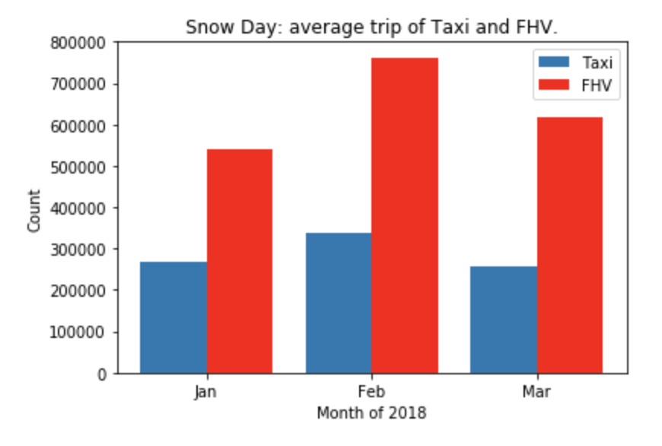
Analytic Questions and Finding
Q3 - What effect does weather (Temp, Rain, and Snow) have on usage of yellow or green taxis vs. For-Hire Vehicles (FHVs)?
Snow
In snow days, people would like to choose FHV.

Slide 13
Post Mortem
With a little more time would may have been able to break down the temperature and precipitation data daily
We could also utilize the dropoff data points to determine preferences depending on length of trip
We did not have access to price per ride for all the trips so we could not see if cost was a factor in making choice
Our analysis only covers the NYC area and only covers 2018 so is therefore somewhat biased

Slide 14


